Slide 1
Used Car Price Prediction.
Capstone Project By Uchenna Austin Okoli (Business Analyst).

Slide 2
AGENDA
Overview
Data Preparation
Recommendation
Business Question
Data Building & Evaluation
Data Processing
Comparison & Regression KPIs
Data Exploration
Conclusion

Slide 3

Overview
Buyers, car fleet managers, used car dealers and car insurers have to evaluate the ‘right’ price for a used car. More than the right price, they thrive on identifying the car depreciation because it impacts all subsequent decisions: should the owner sell the car? What is the replacement value of the car for the insurer? Should the car be sold by the car fleet manager?

Slide 4
Business/Data Question
Predict the price of used cars.
Can we estimate selling and buying prices for used cars in an affordable and quick way using predictive models based on available data?
1
3

Slide 5
Data Processing
Data Source > Kaggle.com
Null Values: 2 missing dataset that were dropped
Data Shape(Samples) > 427, 15
Converted the MSRP & Invoice data type to integer.
INPUTS (FEATURES): Model, Make, Type, Origin, Drivetrain, Invoice, EngineSize, Cylinders, Horsepower, MPG_City, MPG_Highway, Weight, Wheelbase, and Length.
OUTPUT: MSRP (Price)

Slide 6
Data Exploration & Analysis

Slide 7
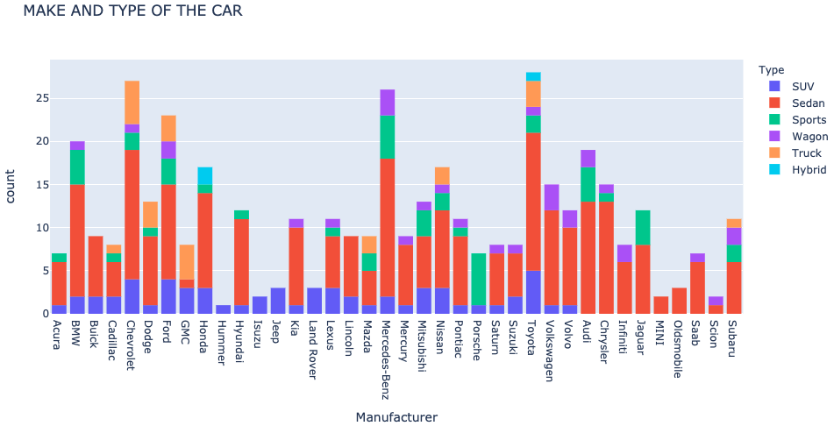
Data Exploration
Histogram showing make and types of cars..
Answering some Visualization questions:
Which manufacturer has high number of Sports type?
Which of the manufacturers has Hybrid?

Slide 8
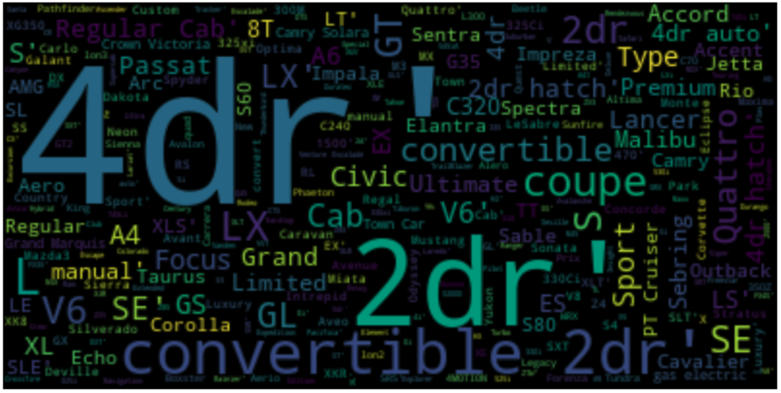
Data Exploration
View of all models of used cars with the use of Word Cloud generator.

Slide 9
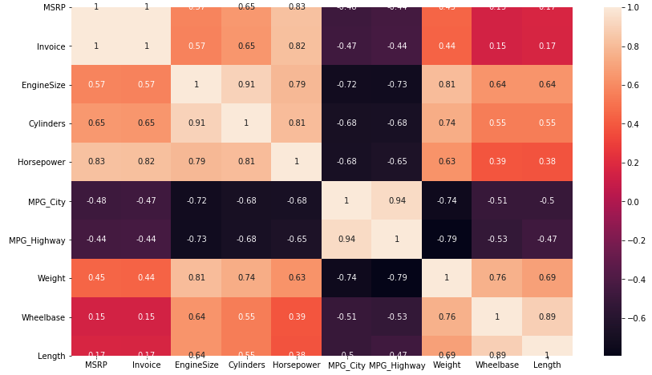
Data Exploration
Positive correlation between engine size and number of cylinders
Positive correlation between horsepower and number of cylinders
highest positive correlation with MSRP is = horsepower

Slide 10
Data Preparation
One-Hot Encoding
A process of converting categorical data variables so they can be provided to machine learning algorithms to improve predictions.
“Model”
“Origin”
“Make”
“Type”
“DriveTrain”

Slide 11
Modeling & Evaluation
From the above results, it clearly shows that the XGBoost model scores 83% accuracy which outperforms other models.
This was achieved by using an ensemble machine learning technique that works by training weak models in a sequential fashion called BOOSTING.
XGBoost
83%
Random Forest
78%
Decision TR
67%
Multiple Linear Regression
63%

Slide 12
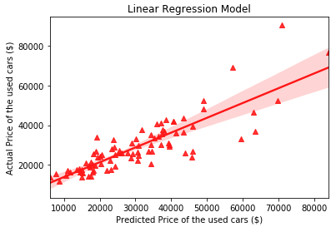
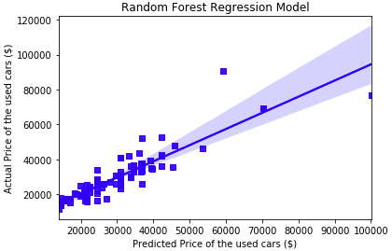
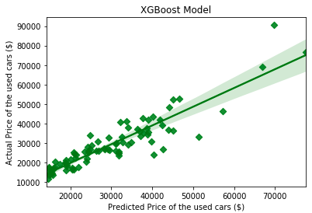
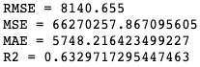
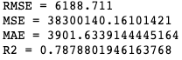
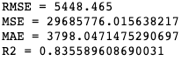
Model Comparison & KPIs

Slide 13
Conclusion
By evaluating the performance of different models, it can be concluded that XGBoost was the ideal model for predicting the price of used cars.
Having built a model that predicted 83,5% of accuracy the price of used cars, given a set of features. This can have an enormous value for dealers and individuals when trying to understand how to estimate the value of a vehicle.
With the analysis of historical data it is possible to find patterns that lead to accurate results, which can provide comparative advantage before putting a vehicle on sale or buying it on the market.

Slide 14
Recommendation
Make use of a larger dataset as more data can yield more robust predictions and there could be more features that can be good for prediction.
Data cleaning process can be more rigorous by making use of more technical information; like filling missing values with indicator that are more meaningful instead of with empty value.
Finding out most relevant features that affect MRSP(Price) would also be impactful to sales decisions.

Slide 15
Thank you.

Slide 16
Supporting Documents
https://github.com/uchino83/IOD/blob/main/capstoneproject_dataset_cars_data.csv
https://github.com/uchino83/IOD/blob/main/Capstone_Project%20-%20Uchenna%20Austin%20Okoli%20-%20Used_Car_Price_Prediction.ipynb

